Slide 1
Carroll Gardens Community Assessment -11231
Michelle, Avital, Natali, Sarra
NUR 460: Community Health
April 14th, 2022

Slide 2
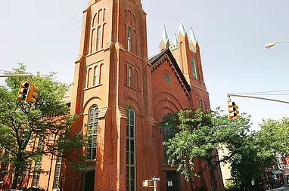
Community Core and Support Data
Majority race is whites and Native Americans (Furman Center for Real Estate and Urban Policy, 2021).
Cultural landmarks in the city include John Rankin House, South Congregational Church, and Invisible Dog Art Center (Peacock, 2014).
The city was originally established in 1863, and expanded due to immigration of foreigners into the region (LivingPlaces, 2021).
Whites make up 79% of the population, Hispanics making 9.4%, Asians at 5.6%, Mixed races making 4.3%, and Blacks making 1.3% (Statistical Atlas, 2021).
Teenagers make up the largest part of the population.

Slide 3
Continuation
The area has nine public schools and two private schools (Zip code 11231 New York Education data, n.d.).
Most residents in Carroll Gardens have no medical care
This zip code caters to Roman Catholics, Episcopalians, and Baptists (Park Slope and Carroll Gardens, 2015).
Community strengths include public libraries, parks, education systems, transport systems, and icon architecture
The health risks include smoking, a poor diet, and physical inactivity
The zip code faces challenges related to access to health care, diversity, and financial inequities (Gardens, 2022).

Slide 4

Community Analysis
The leading causes of health problems in this area are poor diet, lack of exercise, and smoking
The main health problems facing this area’s population are obesity and hypertension
Carroll Gardens has a 15% obesity status, while hypertension targets 22% (Community Health Profiles, 2019).
13% of the population is overweight (Community Health Profiles, 2019).
86% of the population exercises at least once a month (Community Health Profiles,2019).

Slide 5
Continuation
Carroll Gardens 11231 is among the healthiest communities
The area advocates for healthy eating and staying active
Young children and older people are encouraged to stay physically active
Pollution, specifically air pollution, is a key health problem (Community Health Profiles,2019).
The overall health of the population in the area is excellent

Slide 6
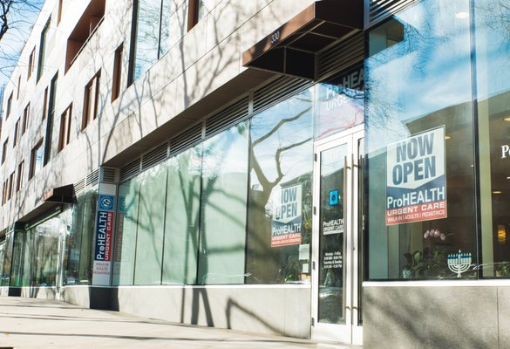
Interventions
Offering proper guidance in exercising
Offering proper guidance on nutrition
Educating the residents on the importance of sleep concerning obesity (CDC, 2021).
Encouraging community members to visit nearby healthcare centres for checkups frequently

Slide 7
Continuation
There is a need to teach the community about proper diets
Encouraging residents to consume foods rich in fiber
There is a need to encourage people to stop smoking habits
Encouraging frequent visits to primary care physicians (CDC, 2021).

Slide 8
References
Carroll Gardens - New York City. (2021) Carroll Gardensn https://www.niche.com/places-to live/n/carroll-gardens-new-york-city-ny/
CDC. (2021, December 14). Healthy people - healthy people 2021. Centers for Disease Control and Prevention. Retrieved April 14, 2022, from https://www.cdc.gov/nchs/healthy_people/hp2021.htm
Community Health Profiles 2015. Brooklyn Community District 6 - Park Slope and Carroll Gardens, NYC Health.
Community Health Profiles 2015. Brooklyn Community District 6 - Park Slope and Carroll Gardens, NYC Health.
Furman Center for Real Estate and Urban Policy. (2021). Park slope/Carroll gardens neighborhood profile. NYU
LivingPlaces. (2021). Carroll gardens historic district.
Peacock, J. (2014). Brooklyn fictions: The contemporary urban community in a global age Bloomsbury Publishing.
Statistical Atlas. (2021). Race and ethnicity in Carroll Gardens, New York. https://statisticalatlas.com/neighborhood/New-York/New-York/Carroll

